Slide 1
Oatmeal and Raisins Web Development Group

Slide 2
Problem Descriptions
Username
Email
password
Login
Sign Up
Sign Out

Slide 3
Requirements
Functional
Non-Functional

Slide 4
Overall Solution Approach
Responsibilities
Team inside Teams
Weekly Schedule

Slide 5
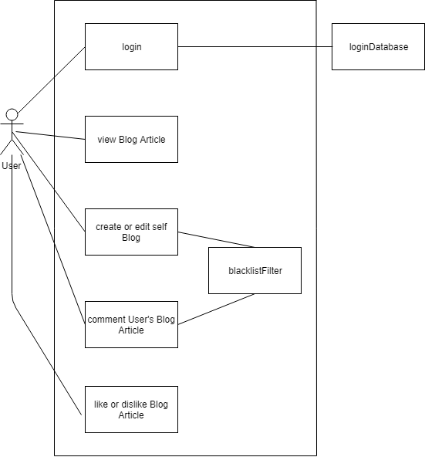
Data Model

Slide 6
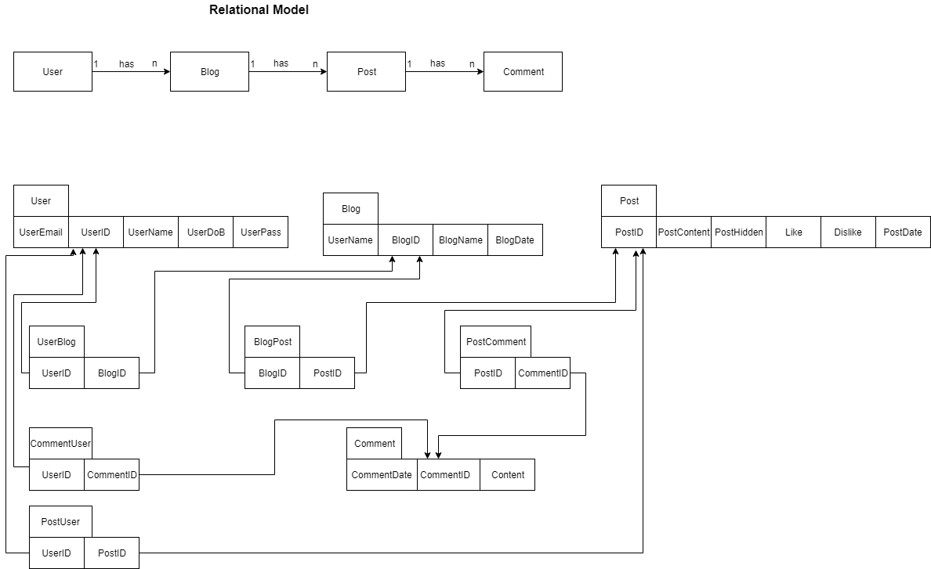

Slide 7
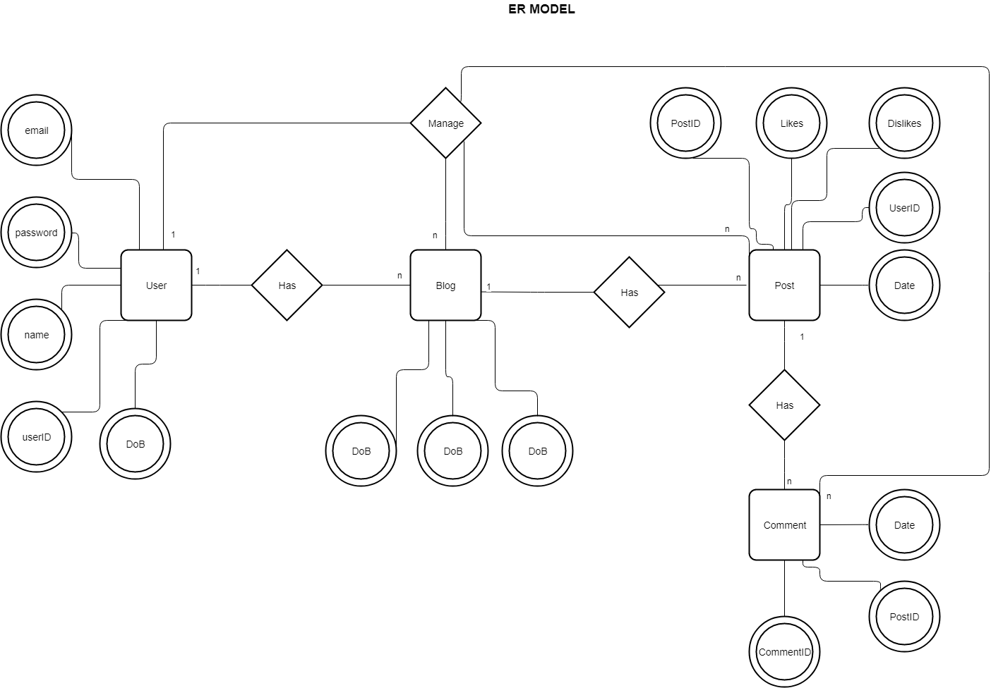

Slide 8
Development Summary
Lines of Code | 1595
Comment Lines | 157
Blank Lines (White space) | 153
Total Lines of Source File | 1905

Slide 9
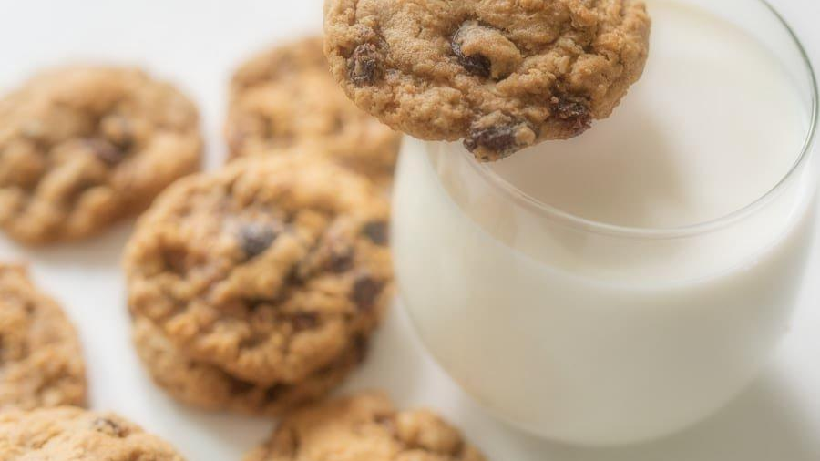
Design and Architecture

Slide 10
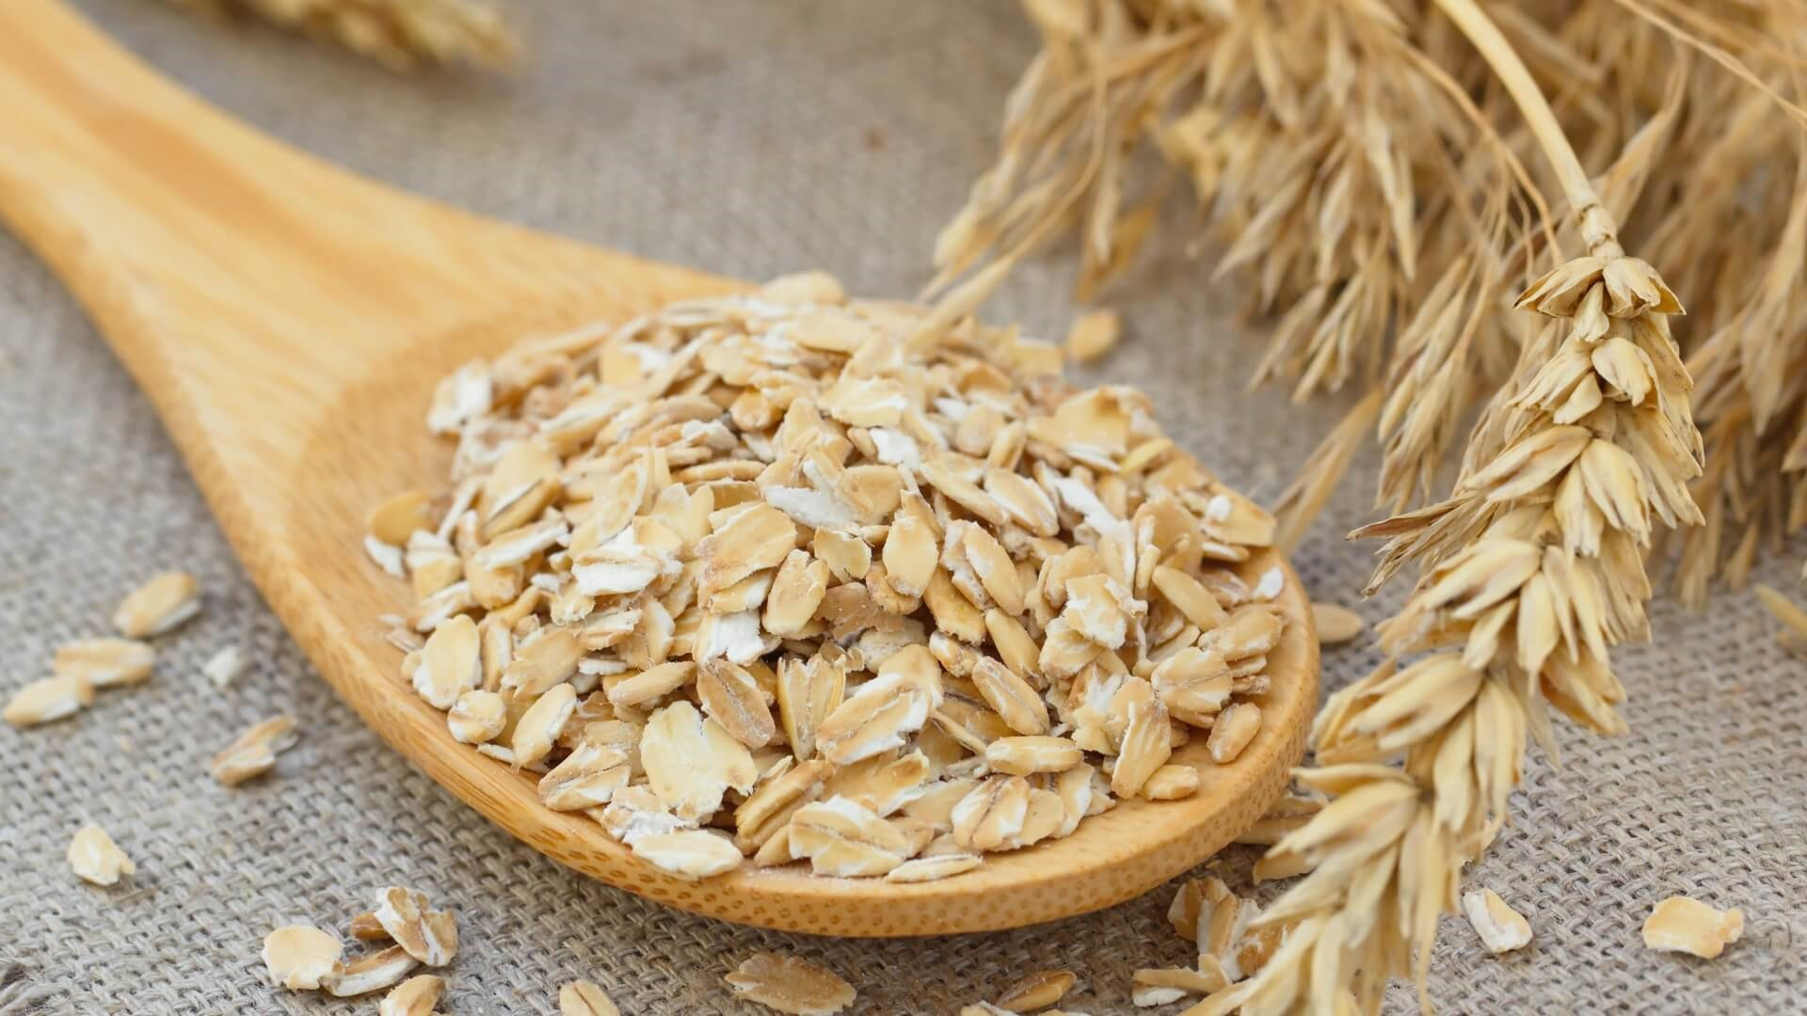

Slide 11
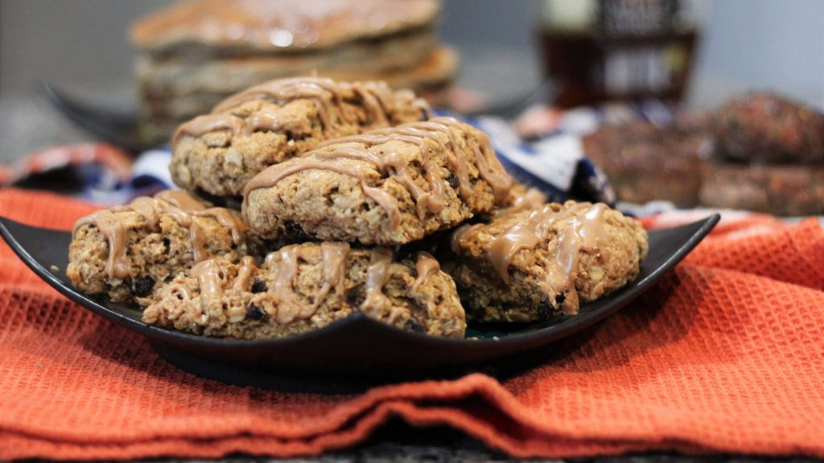

Slide 12
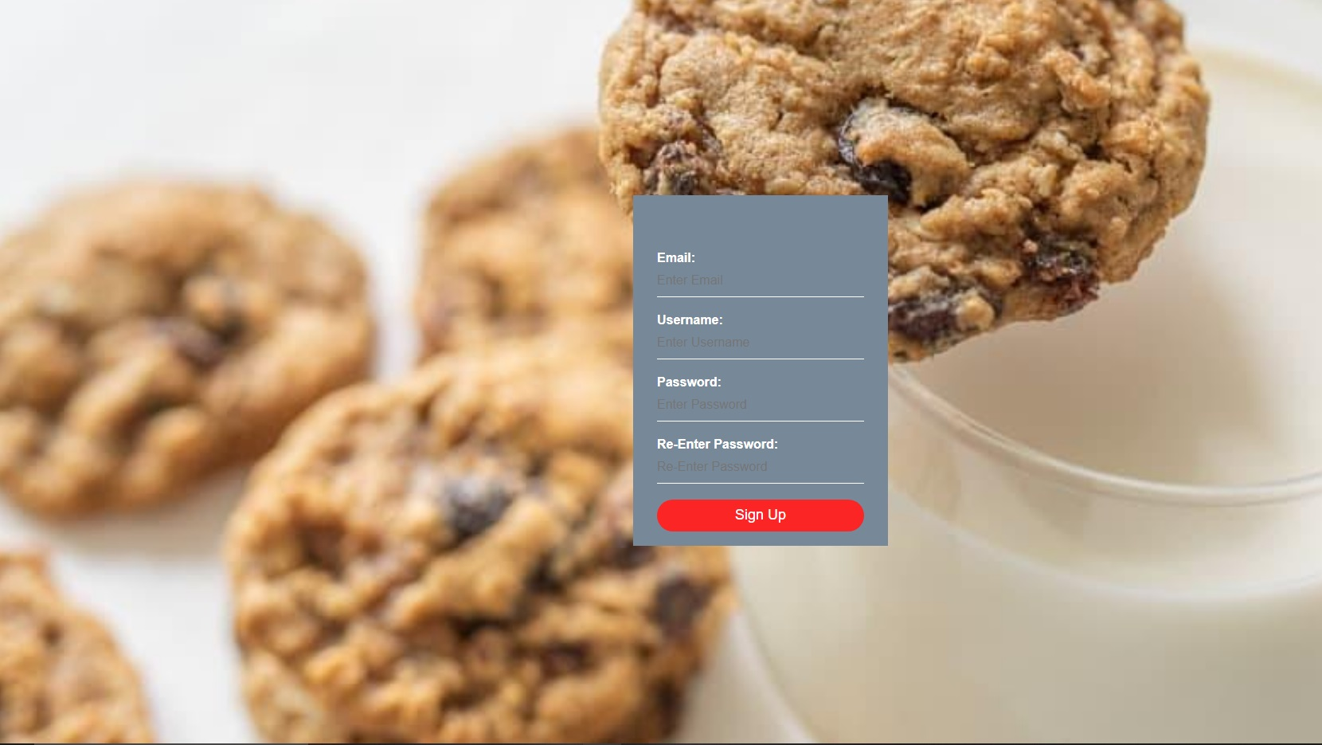

Slide 13
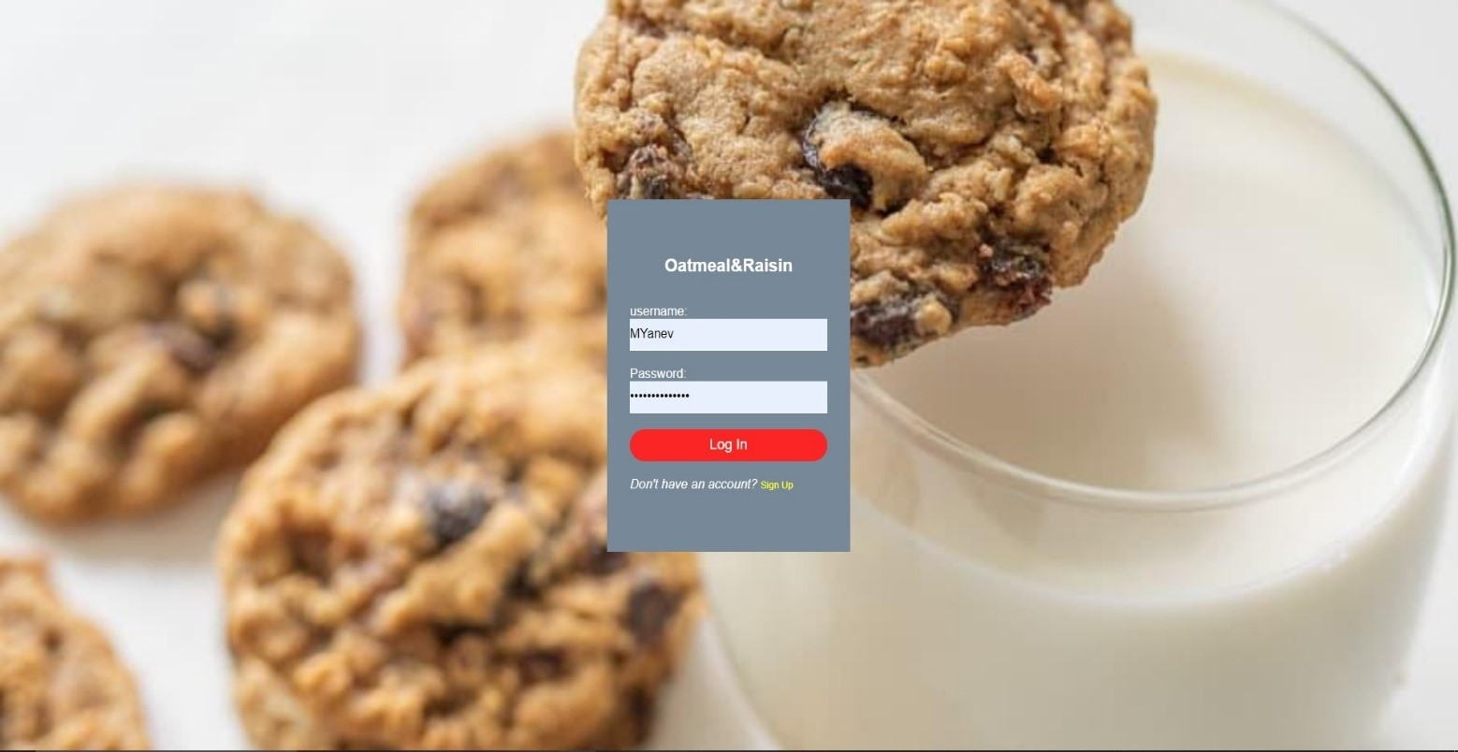

Slide 14
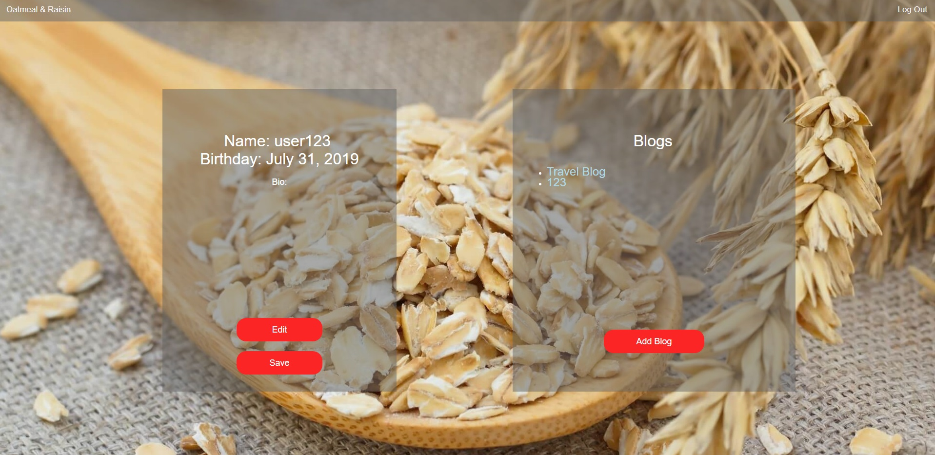

Slide 15
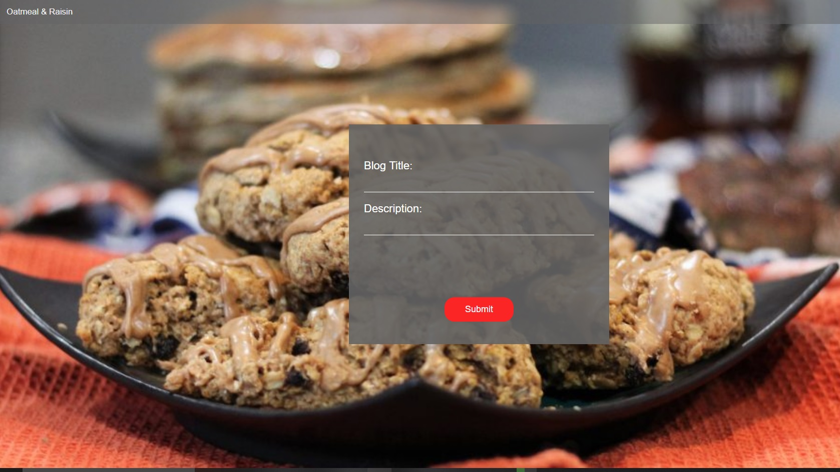

Slide 16
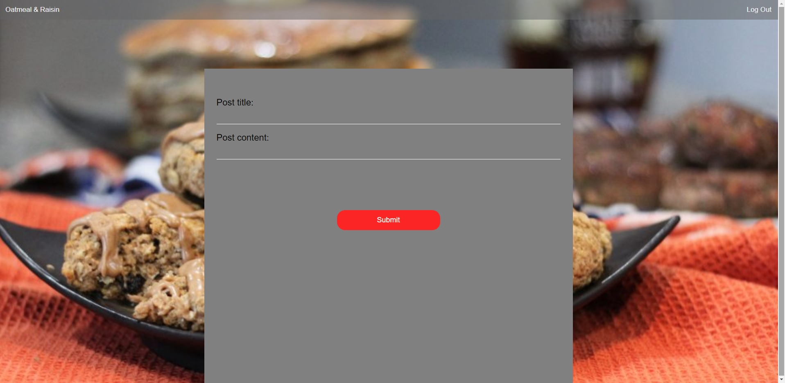

Slide 17
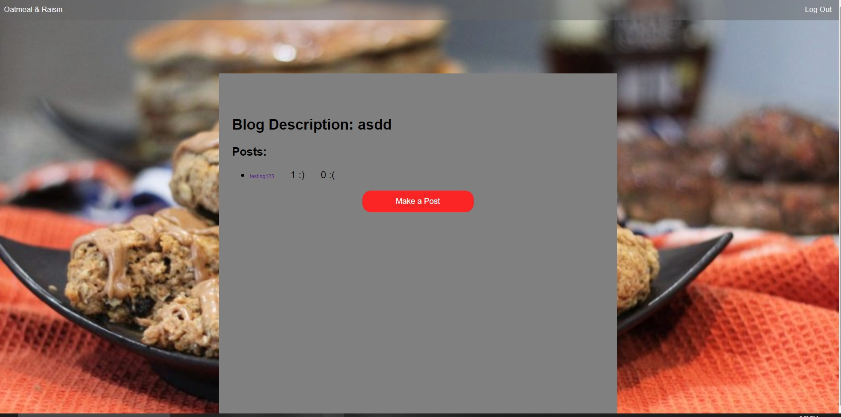

Slide 18
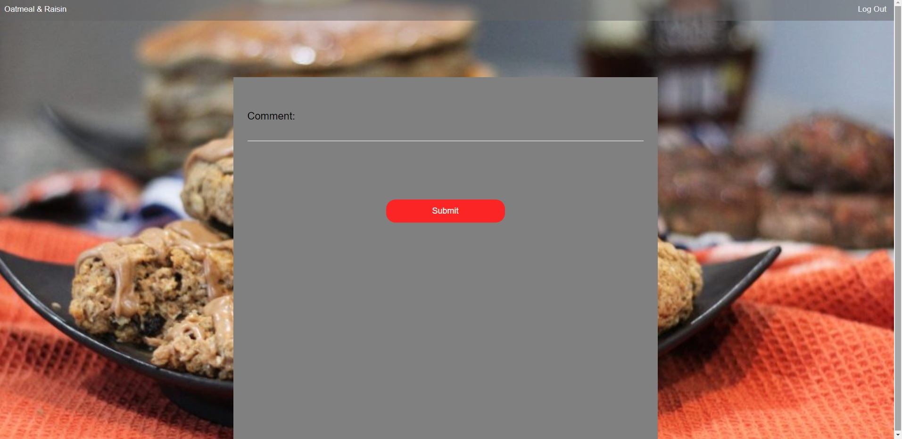

Slide 19
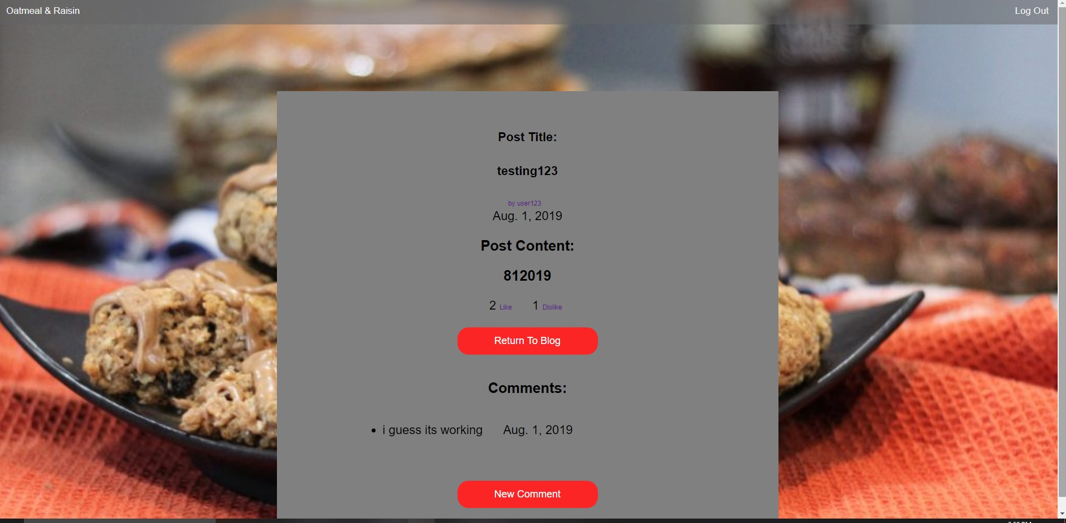

Slide 20
Implementation Details
HTML
CSS
Django
Python
Bootstrap library
MySQL
Proxy
GitHub
Domain

Slide 21
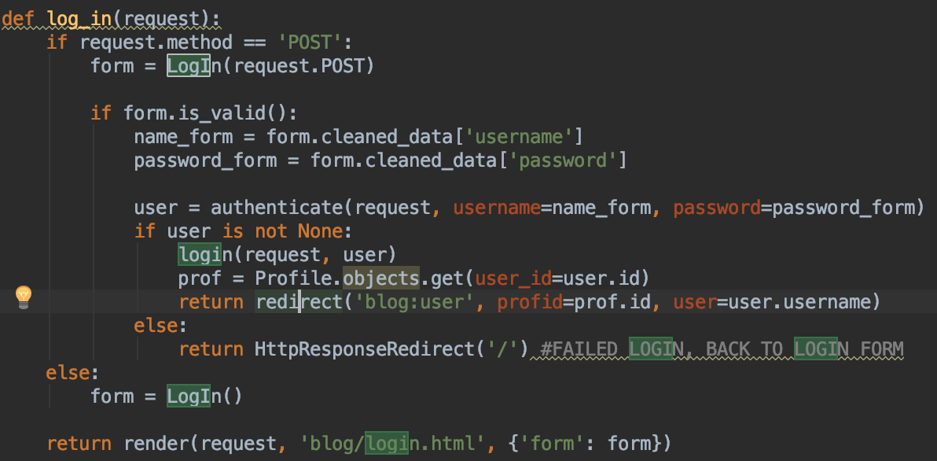
Testing Data

Slide 22
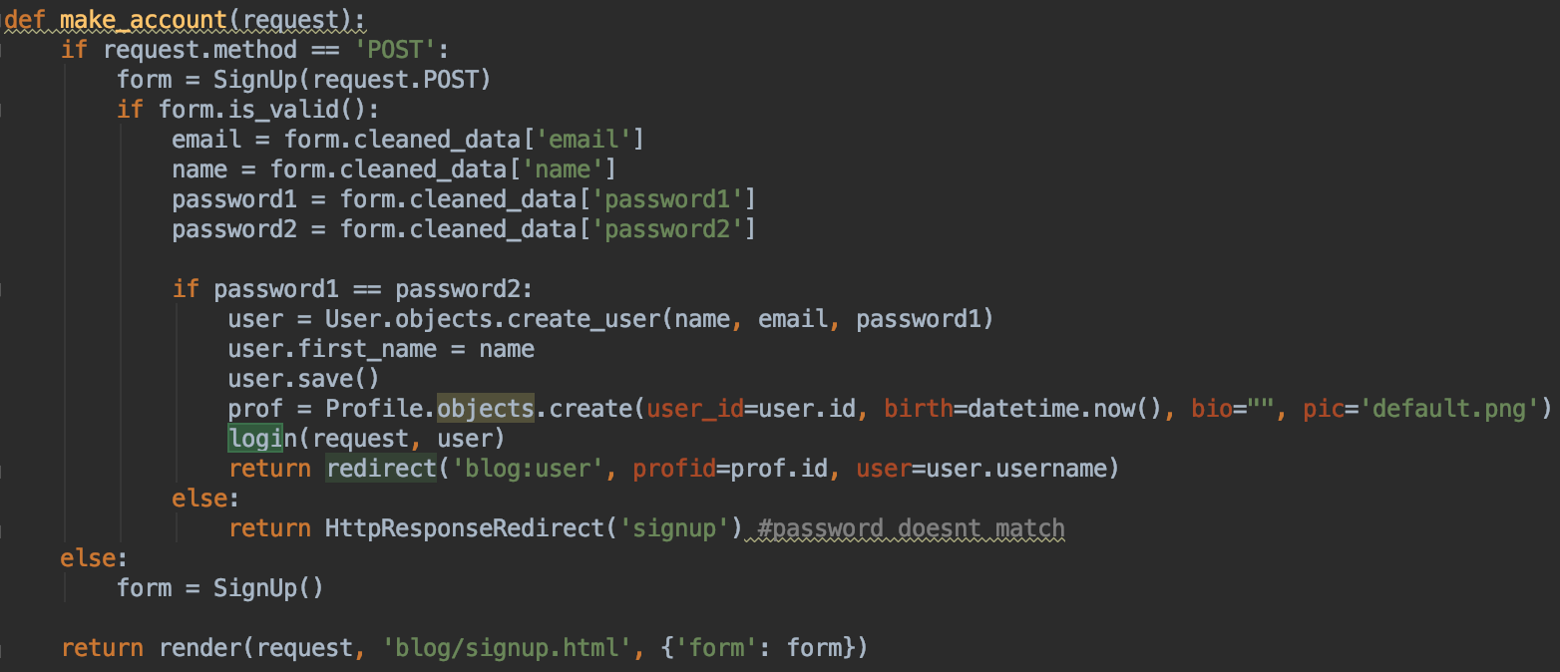

Slide 23
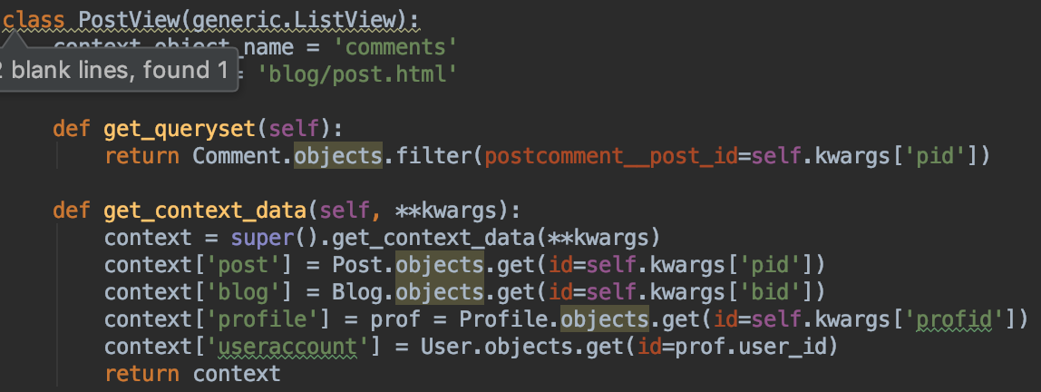

Slide 24
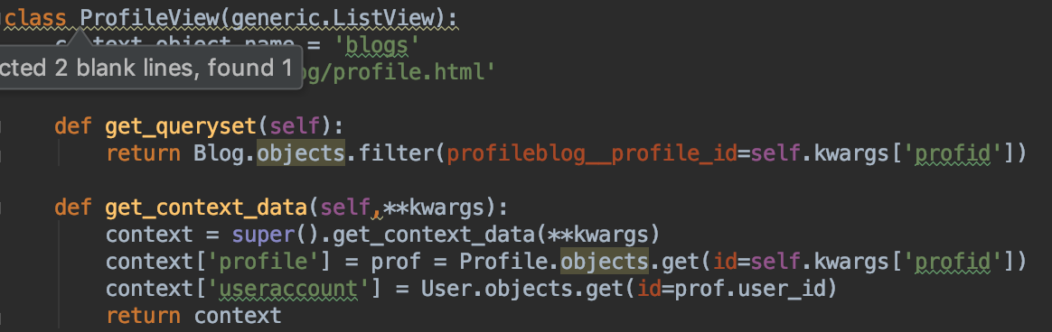

Slide 25
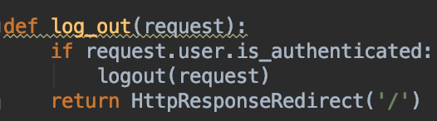

Slide 26
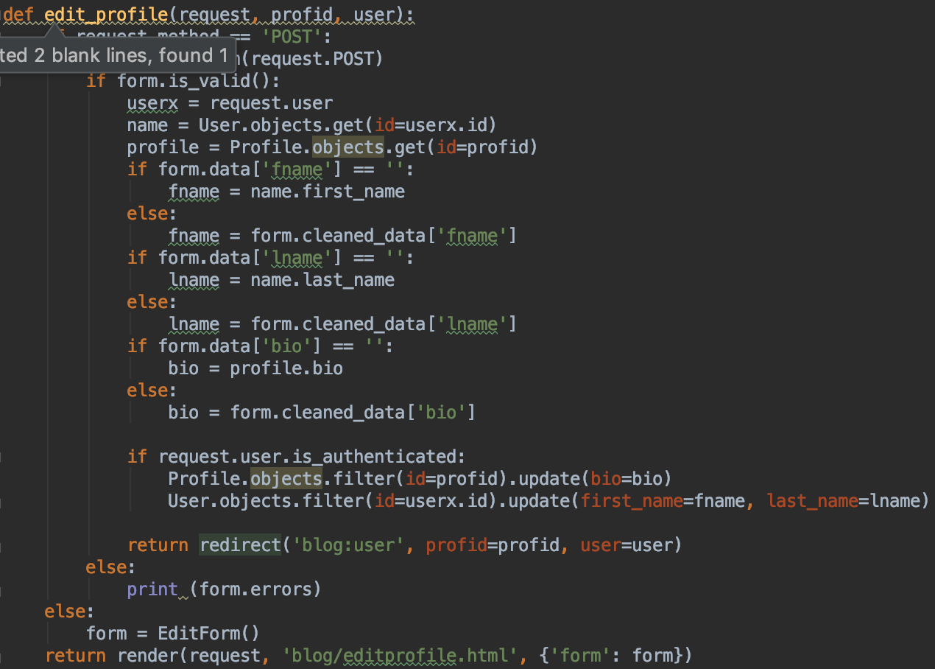

Slide 27
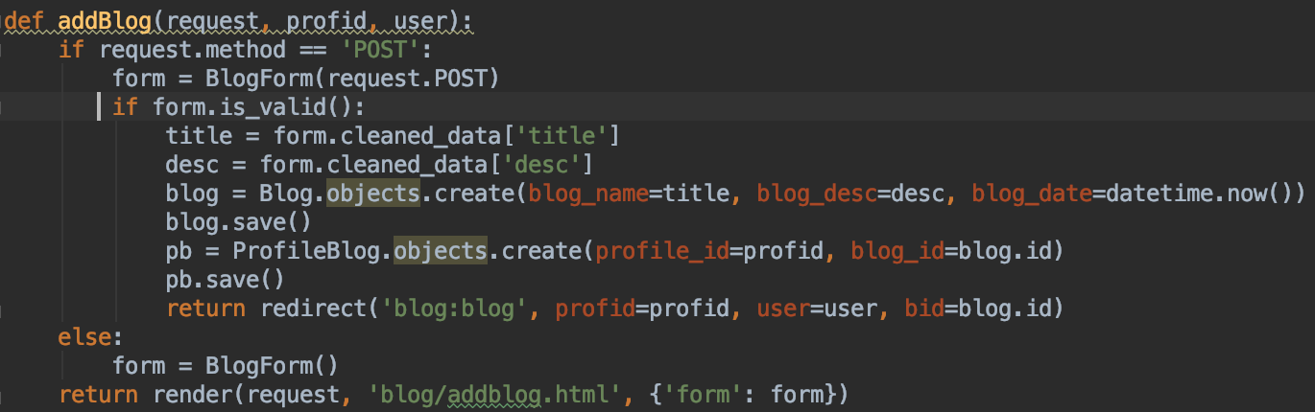

Slide 28
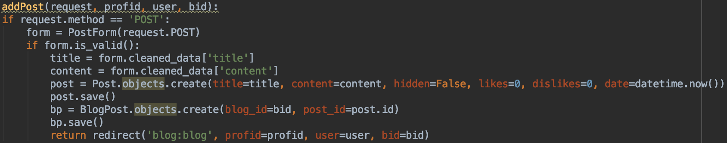

Slide 29
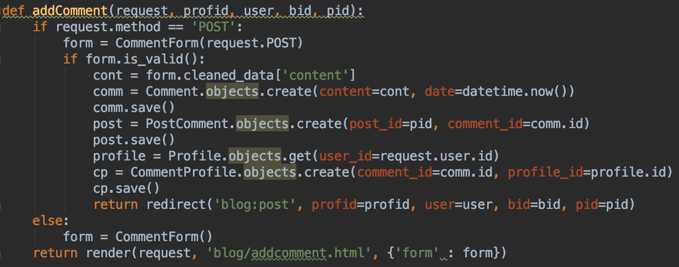

Slide 30
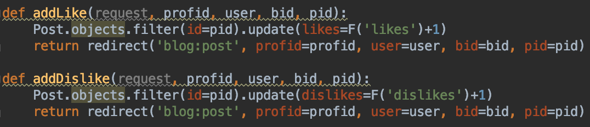

Slide 31
